Slide 1
Supporting Positive Behavior Through PBIS (Positive Behavior Intervention and Support)

Slide 2
Today’s Purpose
To discuss the critical features and essential practices of Positive Behavioral Interventions and Supports (PBIS) and the roles of the Paraprofessional in implementation.

Slide 3
Warm Up
What do you already know about PBIS at Hawthorne?
How do you see PBIS connecting to your role?
Notes:
Discussion with team
Share out

Slide 4
The district is using the Multi-Tiered System of Support (MTSS) to help schools develop a continuum of supports for every EPS student.
Everett Public Schools Systems of Support

Slide 5
What is PBIS?
PBIS is:
  Part of a MTSS systems approach, establishing the social culture and behavioral supports needed for schools to be effective learning environments for all students.
Evidence-based features of PBIS
  Prevention focused
  Define and teach positive social expectations
  Acknowledge positive behavior
  Arrange consistent consequences for problem behavior
  Collection and use of data for decision-making
  Continuum of intensive, individual interventions.
  Administrative leadership – Team-based implementation

Slide 7
What Is Active Supervision?
Notes:
We will next address active supervision and acknowledging appropriate behavior.

Slide 8
What is Active Supervision?
A proactive approach used in school settings to monitor large areas with many students, to ensure safety and reduce problem behaviors.
Commonly used in non-classroom settings such as the cafeteria/commons, hallway or playground -where we often have less adult direction and supervision.
In Active Supervision we Move, Scan and Interact
  2010 Susannah Brackett, University of Pittsburgh
Notes:
What is the objective of active supervision?
A: The objective of active supervision is to prevent and correct problems by moving among the students while watching and listening to them carefully and interacting with them in a positive way.

Slide 9
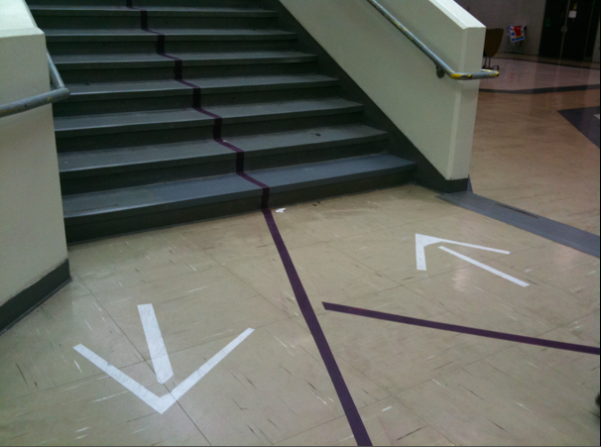
Start with Prevention
How can we decrease the likelihood the behavior will occur?

Slide 10
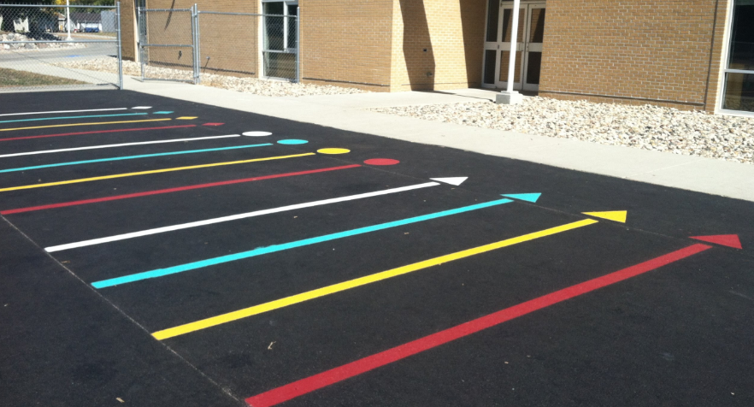
Line Up Zones

Slide 11
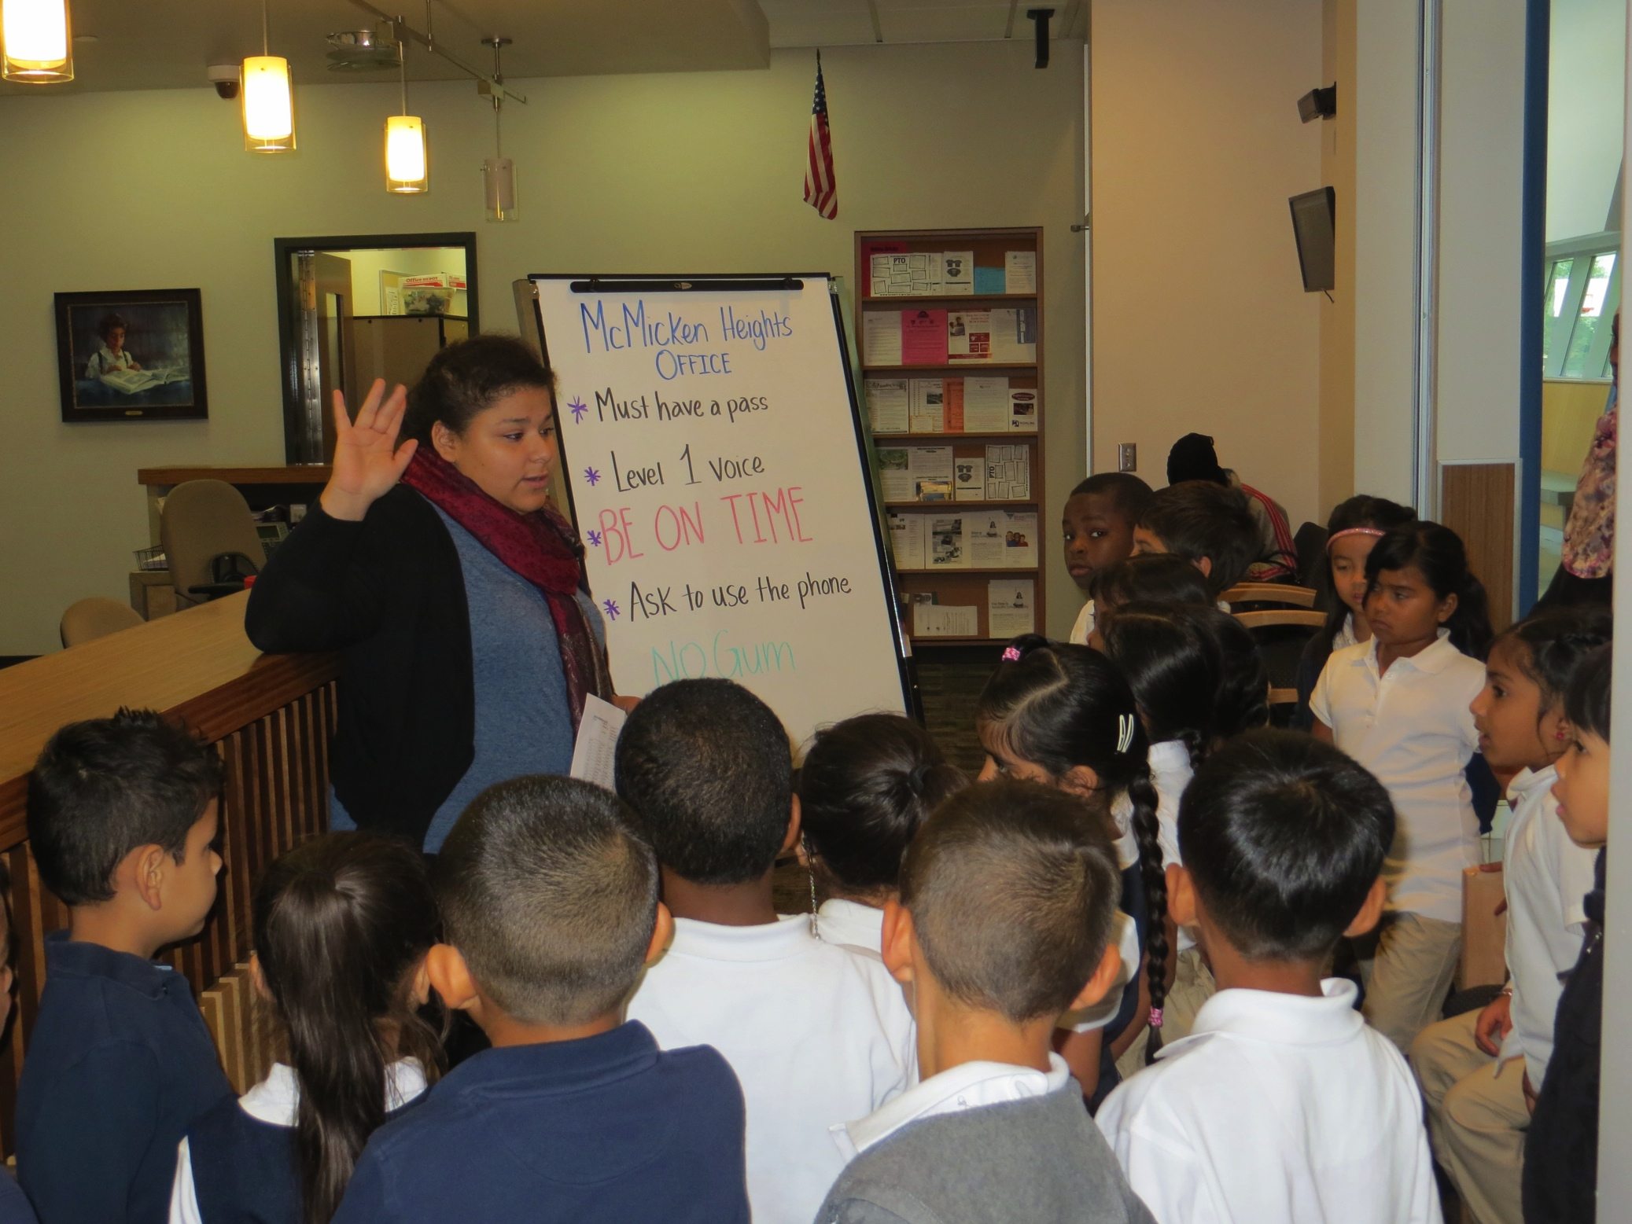
Supervising Staff Help to Teach Expectations at Each Non-Classroom Area

Slide 12
It increases visibility empowers the supervisors as well!
Teaching in the natural context helps students and staff develop shared understanding of what is expected.

Slide 13
Active & Systematic Supervision
Move, Scan and Use Proximity
Proximity and attention are great ways to prevent problem behavior.
Actively move about the area in an unpredictable pattern.
Continue to visually scan the area even when you need to speak with another student.
  Acknowledge Desired Behavior! You will get more of what you pay attention to!
Notes:
13

Slide 14
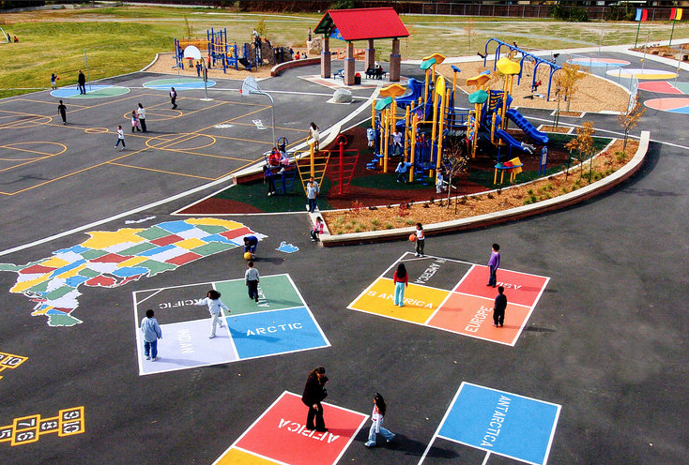
Active Supervision Outside

Slide 15
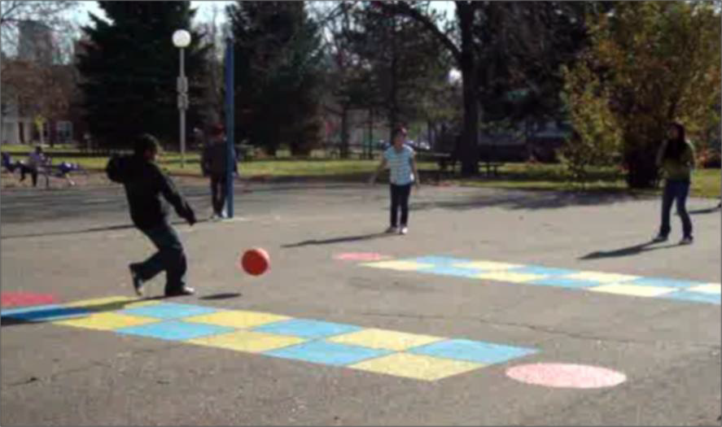
Systems for Recess Success:
Clear expectations
(students & adults)
Playground map
Equipment
Games – schedule & game book
Transitions: to & from the playground
Recess before lunch

Slide 16
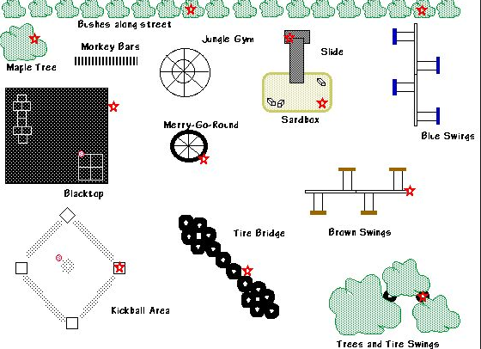
Map It Out & Plan It Out

Slide 17
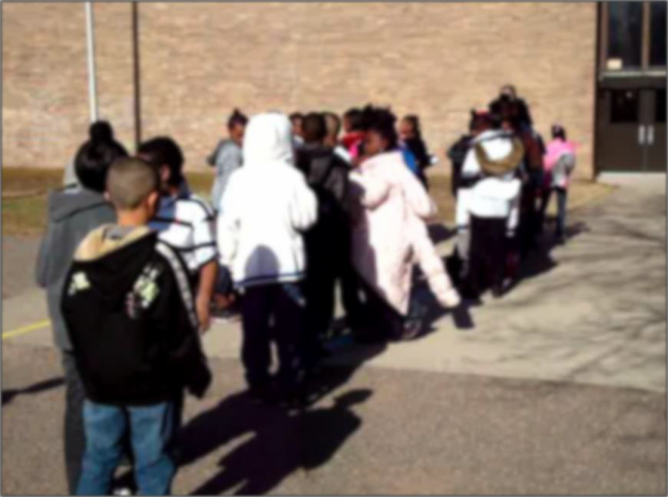
Transitions:
Getting to & from the playground
Stick to the schedule
Consistent line-up routine
Stagger recess ending
Use whistles
Building access

Slide 18
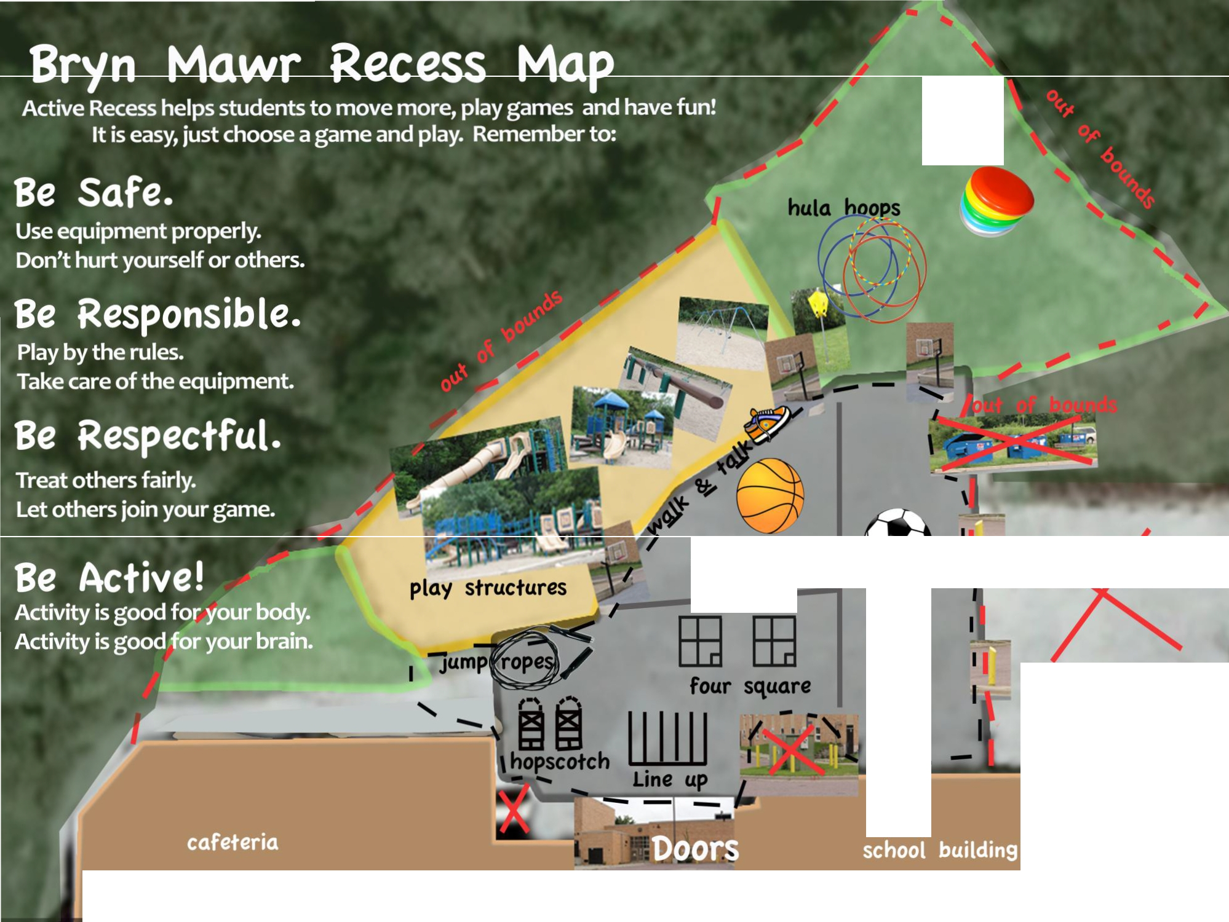


frisbees
basketball
soccer
out of bounds
Check to see which games you can play each day.
Not all game equipment will be out everyday.

Slide 19
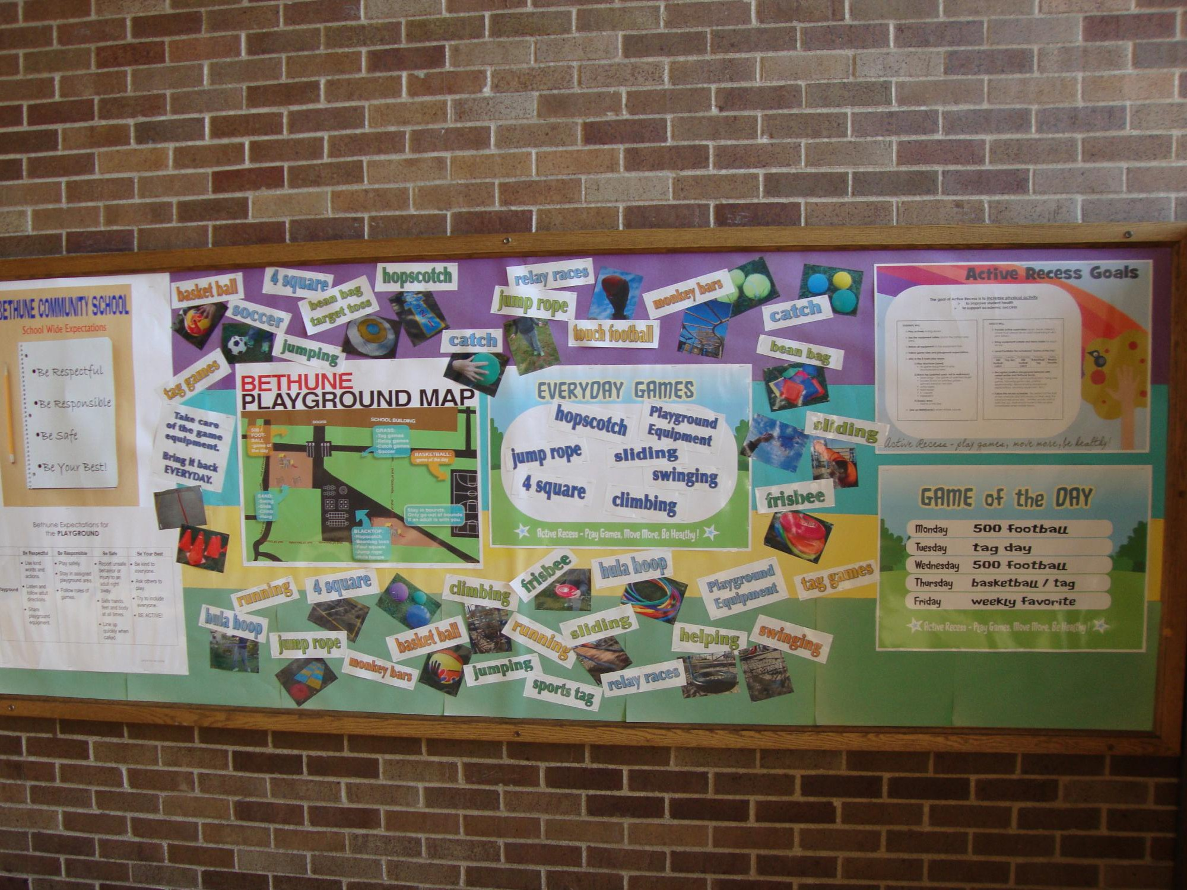
How does Active Recess work?

Slide 20
Supervision Considerations
Who supervises?
How often?
Is supervision “equally distributed?”
Has everyone who supervises received adequate training?
What’s the adult to student ratio?
Are all supervisors visible to students and one another?
What areas need multiple supervisors?
What is the communication protocol for supervisors?
How are subs oriented and placed on map?

Slide 21
Active Supervision: Acknowledgement Systems ……Its About Feedback and Relationships

Slide 22
Move, Scan and Have High Rates of Positive Contact!
Friendly, helpful, open demeanor
Proactive, non-contingent
High rate of positive delivery: 5:1 Ratio
Short (5 to 10 seconds in duration)
Involve groups as well as individuals (so that more kids are affected)
* Sends the “I see you and notice you as a person doing the right thing” message

Slide 23
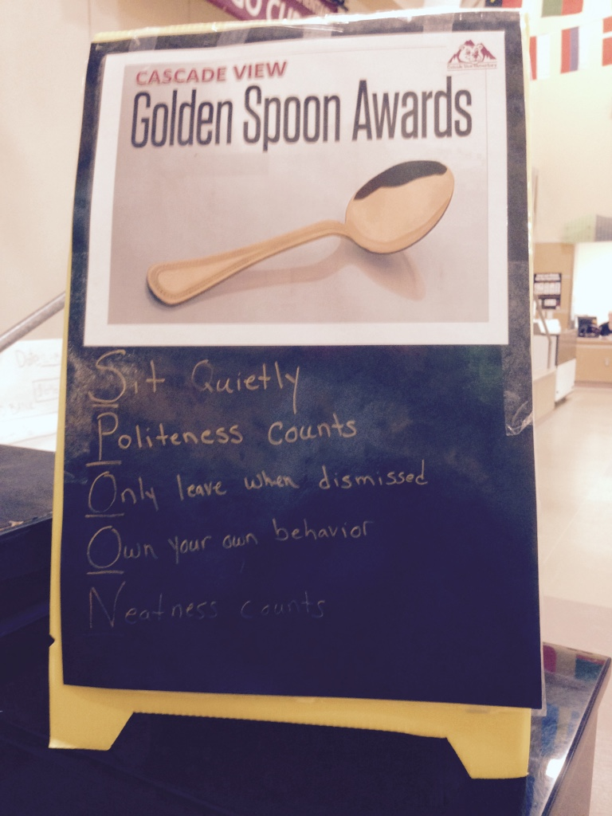
Example: Recognition for Commons Expectations
Golden Spoon handed out to tables by lunch supervisors for following established expectations
Tables that have the Golden Spoon on them get to leave a little early for commons/ playground
Kids who are frequently at a Golden Spoon table or go the extra mile can earn ”go to the front of the lunch line (politely) tickets.”

Slide 24
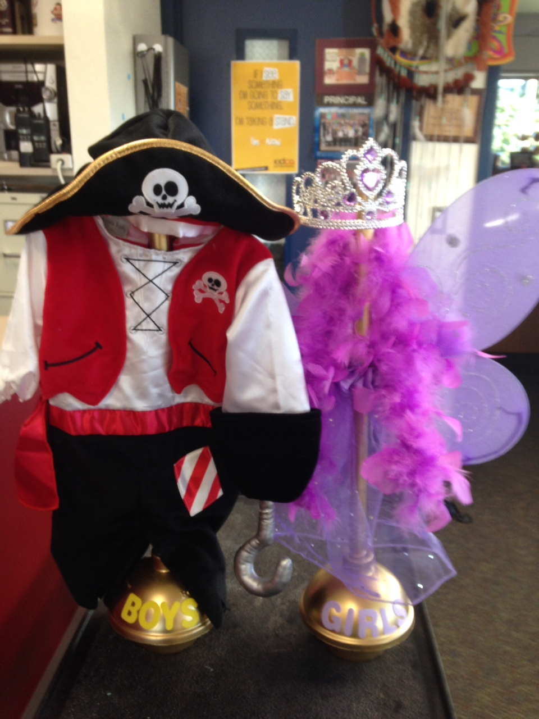
Pt. Defiance – Golden Plungers!!!
Custodian awards the Golden Plunger to hallway with cleanest bathrooms at end of day. Classes in that hallway earn “credit” towards extra recess time.

Slide 25
Active Supervision: Addressing
Behavior ERRORS
Interacting Frequently
Corrective response
  Non-argumentative, noncritical- specific to behavior
  Systematic = correct, model, practice, reinforce
  Be Calm, Consistent, Brief, Immediate, Respectful
  Reconnect with student
Follow through on consequence
  Neutral, businesslike demeanor
  Fair, non-arbitrary
  Clear and firm
  In alignment with school plan and policy
  Reconnect with student
Notes:
Interactions with students while providing active supervision will sometimes require a corrective response.
The use of corrective strategies for inappropriate or low-level problem behaviors can be effective if the response is…
a) Immediate,
b) Nonpersonal, nonargumentative, and noncritical
c) Specific to the behavior and provides an opportunity for reteaching and student practice.
If it is necessary to deliver a consequence the following guidelines can make the interaction more effective…
To the greatest extent possible, take the student aside – never reprimand or potentially embarrass students in front of others if you can avoid it.
Review what you saw with the student in a calm, impersonal manner. Don’t argue and don’t be drawn into an argument. Define the problem and establish a clear focus on the appropriate behavior.
Give the student choices on how to correct the problem and accept the consequences.
If the student is compliant when given a correction or consequence, the process should take no more than a couple of minutes to complete.
*To follow up on a corrective or consequence interaction, actively look for the student to do the right thing and consistently reinforce the appropriate behavior as often as possible.

Slide 26
Response Strategies & Error Correction
Continuum of Error Correction Strategies . . .
Prompt = visual or verbal cue
“Show me that again with walking feet”
Redirect = restate expected behavior
“Please be responsible by having your lunch ID ready”
Tell and acknowledge
“I can dismiss you to recess when your table is clean.” “Thanks!”
Provide Choice
“During commons you can sit with friends at the tables or work in the quiet area of the library..”
Speak with the student directly (away from peers)
“Please step over here with me so we can talk.”
Notes:
26
Finally, Error Correction is sometimes best addressed by conferencing with a student.
Just as we do with an academic error, our goal in responding to a social or behavior error is to teach students what we want them to do instead. Remember, scolding, berating, ridicule and yelling are the LEAST effective ways for addressing misbehavior.
When students make a learning error on an academic task we don’t scold or berate them. We give encouragement, show where the error was made, tell how to make a correction, give opportunities for practice and then provide immediate feedback.
Same things need to happen when responding to behavioral errors.
In short…using a structured conference with a student may help meet this goal.

Slide 27
The 2X10 Strategy: Making Connections
(Smith & Lambert, 2008)
Try 2 X 10!
  Spend 2 minutes a day for 10 days in a row
  Focus on acknowledgement, getting to know them beyond their school work and show genuine caring/connection. (Even if they don’t respond immediately keep it up)
Improves behavior and student connection to school by 85%
Small, consistent investment = big change
Relationships matter!

Slide 28
Acknowledging Positive Behavior & Building Relationships Conversation
How could you use acknowledging positive behavior more effectively in the settings you supervise and support?
What strategies do you use to quickly correct behavioral errors so that you can continue active supervision?
Is there a student or students you know who would benefit from the 2x10 strategy?
Notes:
Connect to your school-wide system. Tokens, notes home, etc. Not all kids want to be acknowledged in the same way. Will use different methods for different ages.

Slide 29
Using PBIS to Support
Student Learning & Progress
Provide training and prompts/supports to give students positive alternatives to meet their needs
Keep problems from occurring. Most energy and time should go here…
Student Progress
Prevent
Undesired Behavior
Teach
Desired or Replacement Behavior
Reinforce
Emerging Desired Behaviors
Acknowledge attempts at new skills & behavior, calmly delivered accountability for behavior errors
(Modified from 2009, Dunlap, Lovannone & English)

Slide 30
Strategies to Support Your Planning!
P | T | R
Prevent | Teach | Reinforce/ Recognize
Clarify or Establish Clear, Observable Expectations for the Student or Situation Prompts and Cues (signs, reminders, signals etc.) | Clearly Teach/Reteach Expectations in the Specific Setting or Situation | Provide Immediate, Genuine Attention & Acknowledgement School Acknowledgement Options for Individuals or Whole Classes/Groups
Notes:
Sample strategies for this framework- walk through an example

Slide 31
Choose Your Own Adventure…
Try out the PTR Problem Solving Framework. Identify a student who needs some support or a setting that has been difficult to supervise. What strategies might be useful?
Prevent | Teach | Reinforce/ Recognize
Notes:
Talk about this tool as grade level and department meeting tool- try to stay with this time limit, even though it take a bit longer when learning it- but the goal is a tool that could be completed by teacher solo, in grade level or dept meeting efficiently

Slide 33
Some Video Ideas & Other Resources
Sample Recess Supervision Orientation Video
https://youtu.be/pZ3RiZk0Otk
Funny playground expectations vides
https://youtu.be/1_RjwlIs8cs
Fun hallway video:
https://youtu.be/OBSXVzgWOtw
Recess Moves: A Toolkit for Quality Recess (free)
http://www.actionforhealthykids.org/storage/Recess_Moves_A_Toolkit_for_Quality_Recess.pdf

